Slide 1
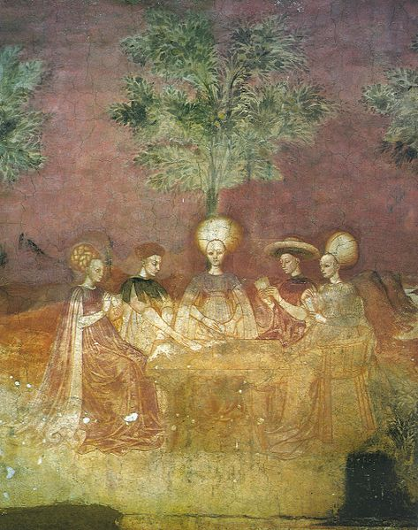
I Cannot Find the Hanged Man
Tarot Cards in Fantastic Fiction
Dr Juliette Wood
The Folklore Society
Katharine Briggs Lecture 2020
commons.wikimedia.org/wiki/File:Tarocchi-players-borromeo.jpg

Slide 2
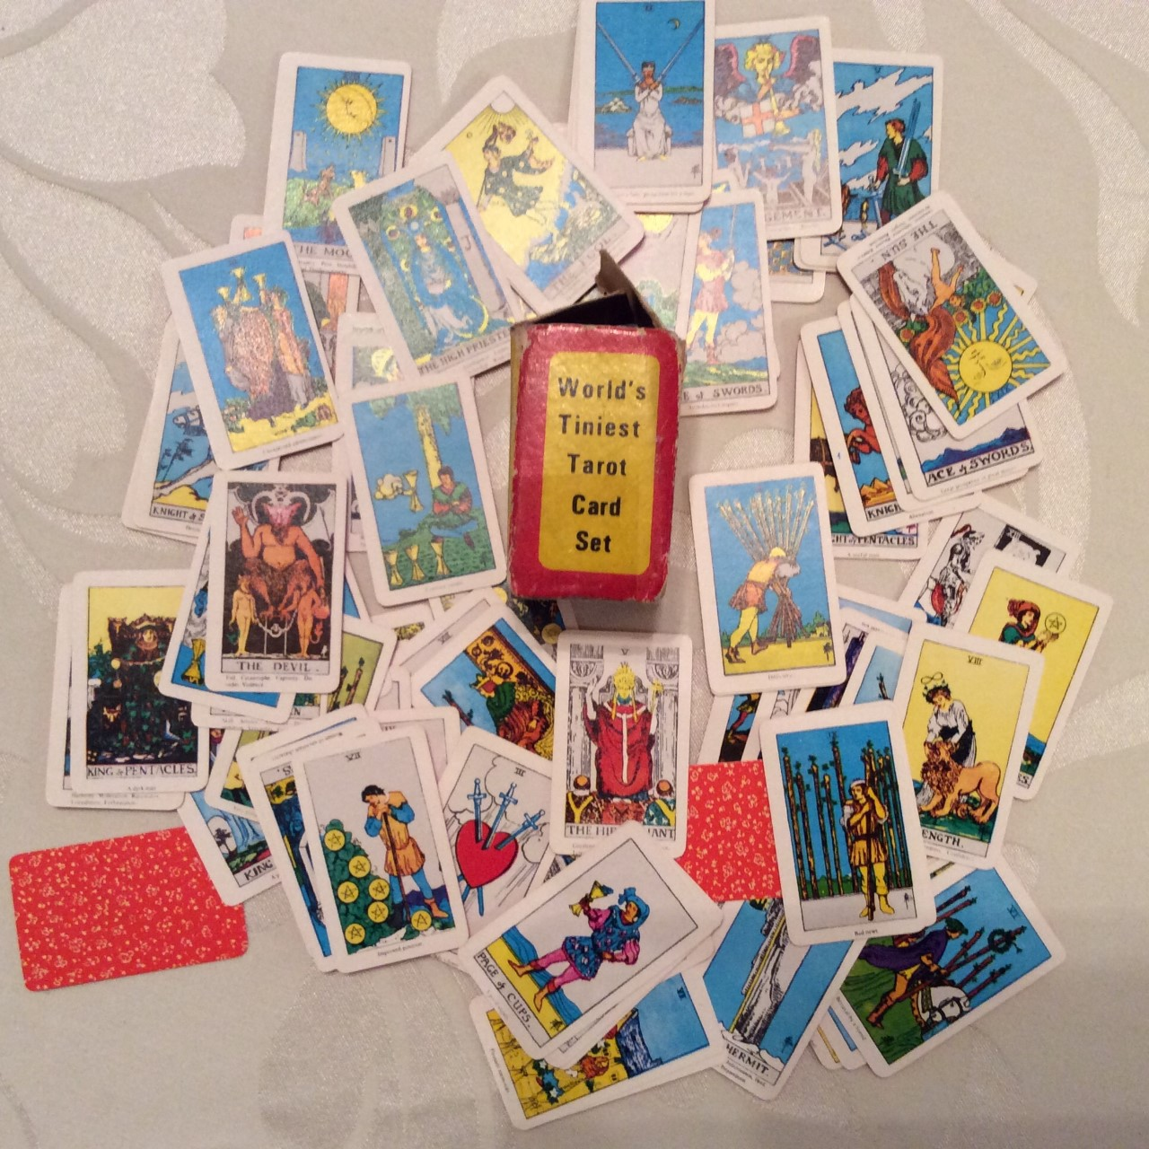
Miniature Rider Deck
printed in Hong Kong
(no date)
Author's collection

Slide 3
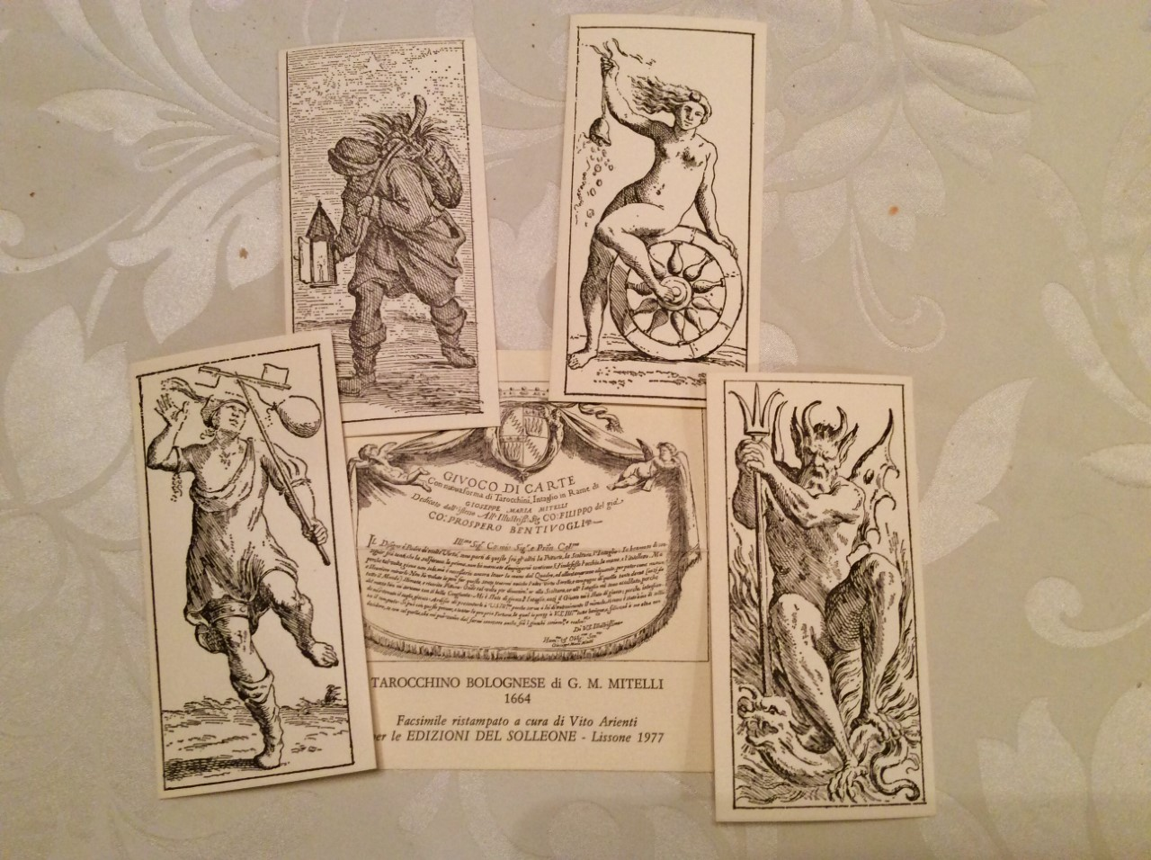
Facsimile of the
Tarrochini Bolognese
1664
Author’s collection

Slide 4
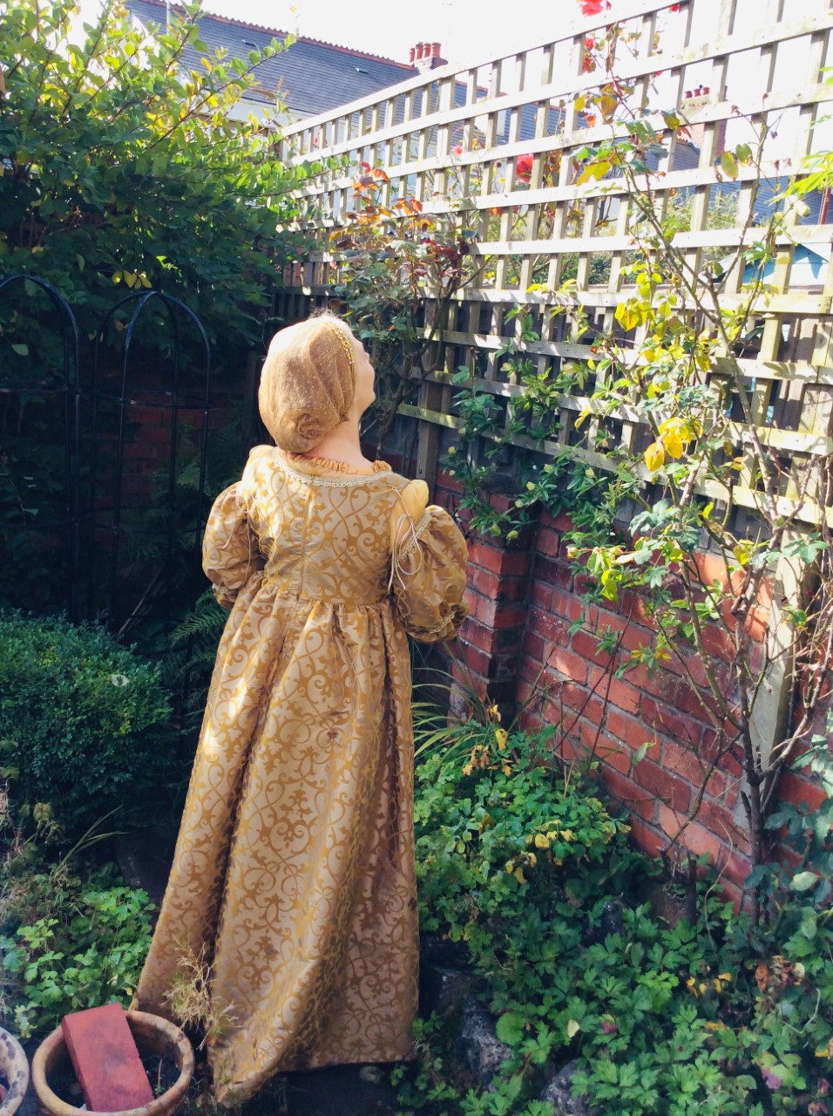
“I have come full circle
and I understand,
the world must be read
backward”
The Castle of Crossed Destinies

